Slide 1

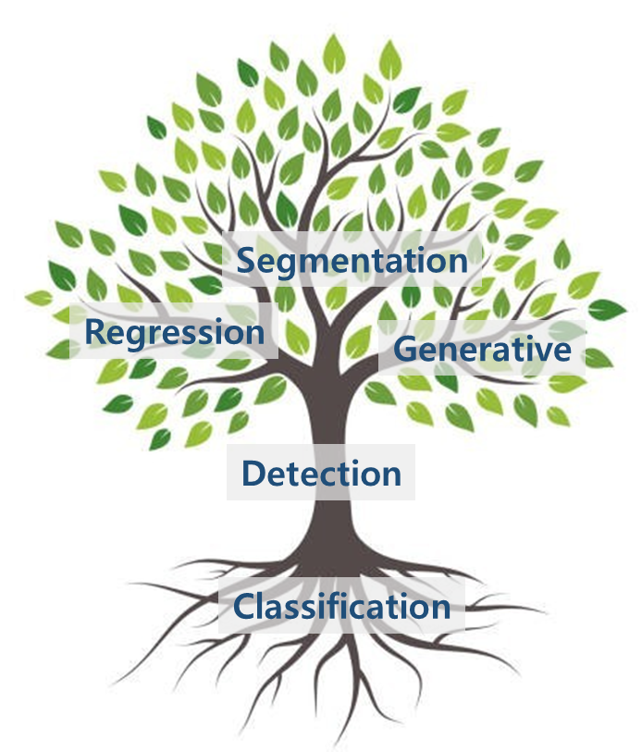
Segmentation
Regression
Generative
Detection
Classification

Slide 2
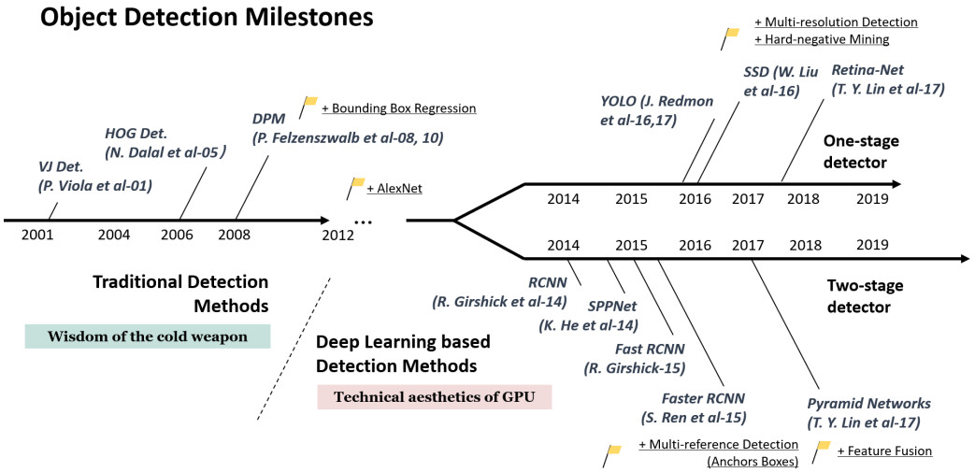
YOLOv3(18)
EfficientDet(20)
YOLOv4(20)
Deformable DETR(20)
2020
Mask R-CNN(17)

Slide 3
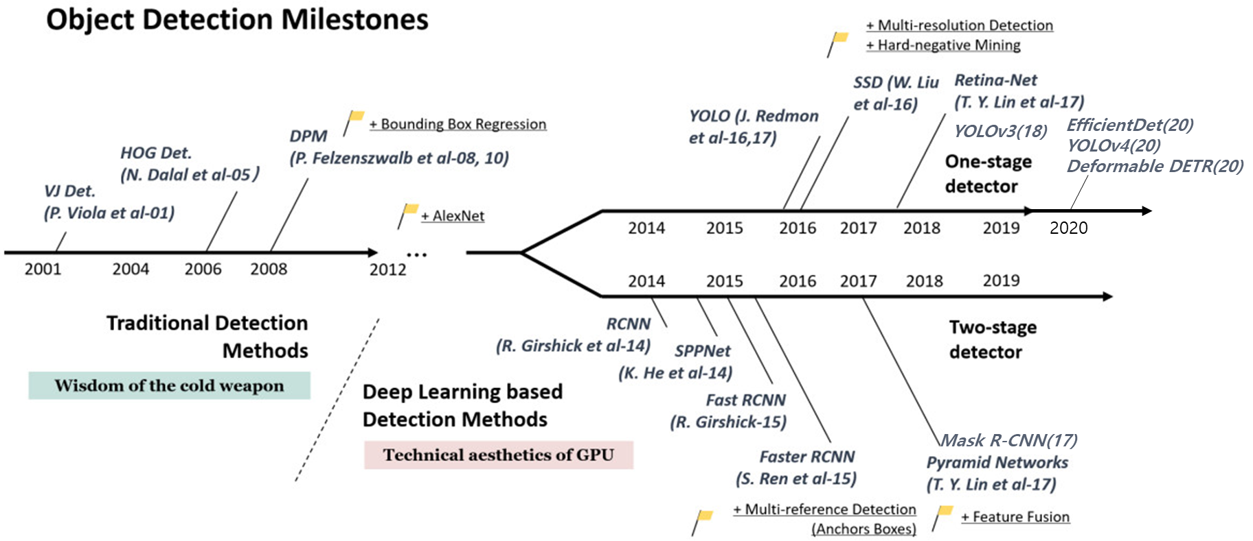

Slide 4
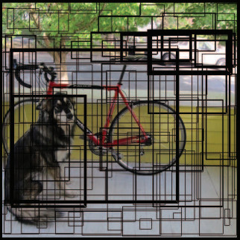
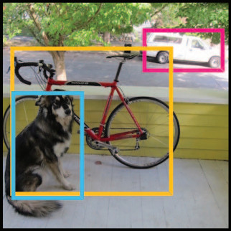
NMS

Slide 5
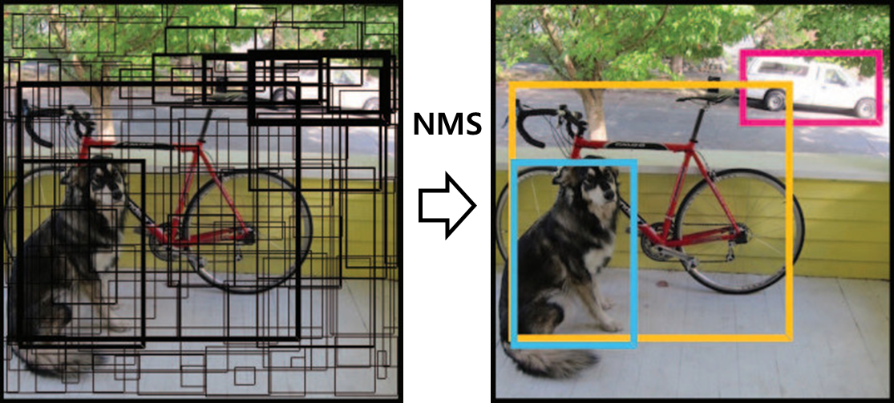

Slide 6
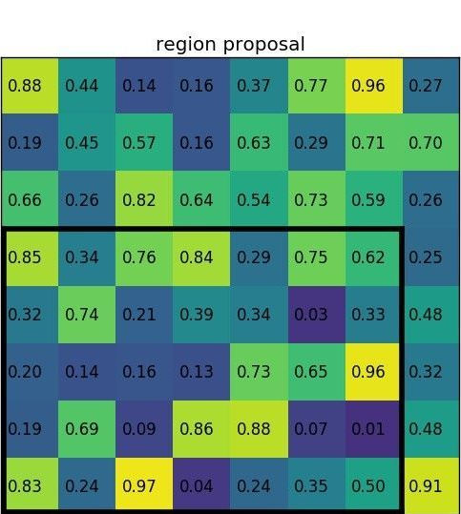
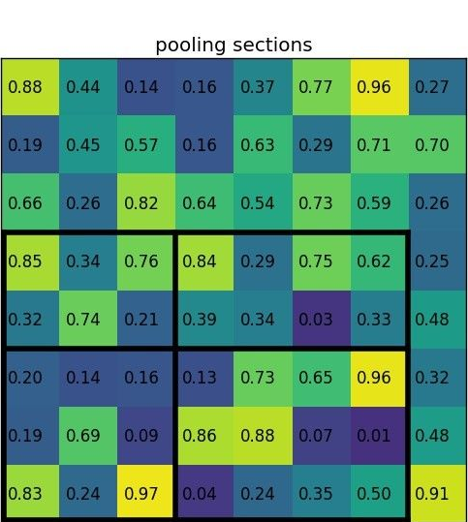
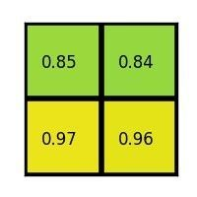
region proposal
pooling sections
max values (result)

Slide 7
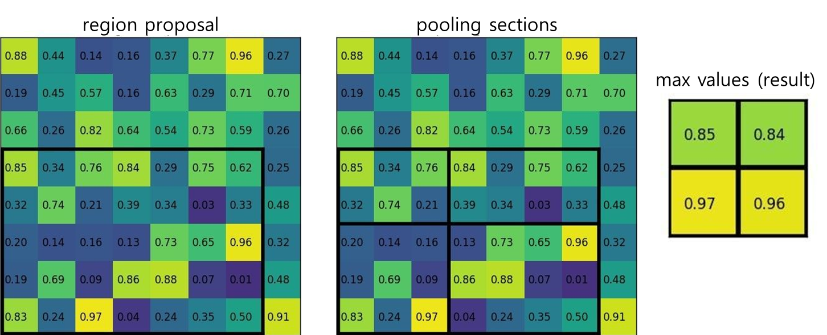

Slide 8


Slide 9
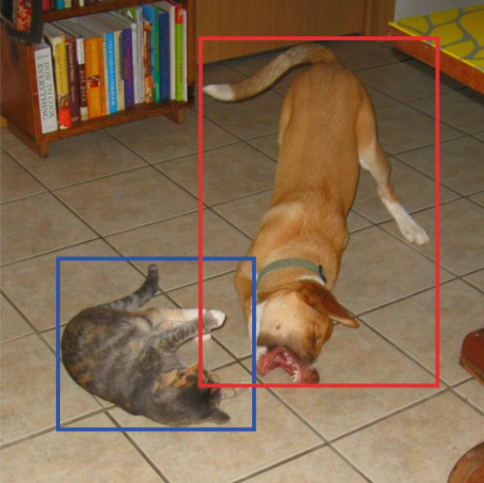
Default boxes
Channels
BBox
Class prob.
BBox
Class prob.
BBox
Class prob.
BBox
Class prob.

Slide 10
